Slide 1
Lecture 9: Higher-order variables in perception and action
The concept of higher-order variables (smart mechanisms)
The outfielder’s problem and strategies to solve it:
TP – trajectory prediction
OAC – optical acceleration cancellation, paired with CB (constant bearing)
LOT – linear optical trajectory
Perceiving throwability

Slide 2
Physical laws vs. computation
“The fish need not construct an internal representation of the hydrodynamics of swimming, only the appropriate sensory-motor loops, the smart mechanisms, are needed. The rest of the required ‘knowledge’ is hidden in the body-form and the interface between body and water. This is a law-governed continuous system... In my opinion law-governed processes should not be called computational or algorithmic.”
-- van de Grind (1988) p. 167

Slide 3
More examples of higher-order variables / smart mechnisms

Slide 4
I. The outfielder’s problem

Slide 5
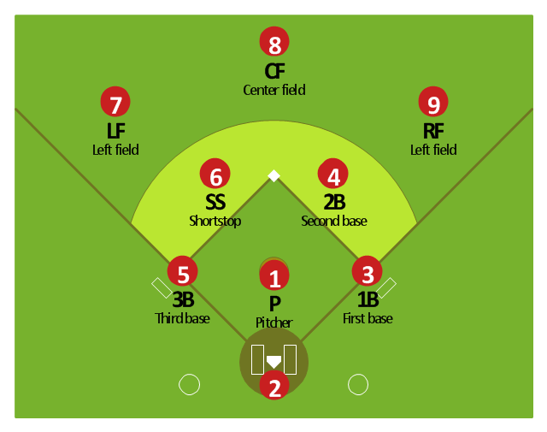
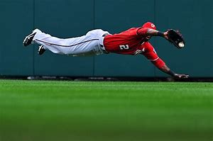

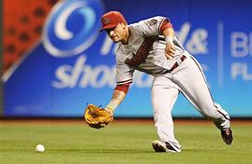
Higher-order variable and the “outfielder’s problem”
The problem: how does an outfielder run to the right place at the right time to catch a fly ball?
What visual info? And how?

Slide 6
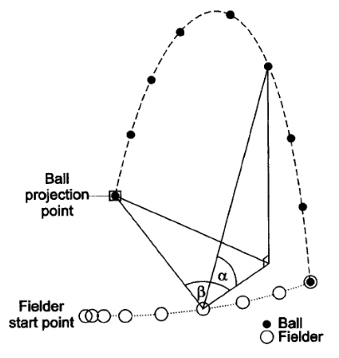
How does the outfielder run to the right place at the right time?
Model-based control (computational models)
Trajectory prediction (TP)
Online control (smart mechanisms)
Optical acceleration cancellation (OAC) strategy
Linear optical trajectory (LOT) strategy

Slide 7
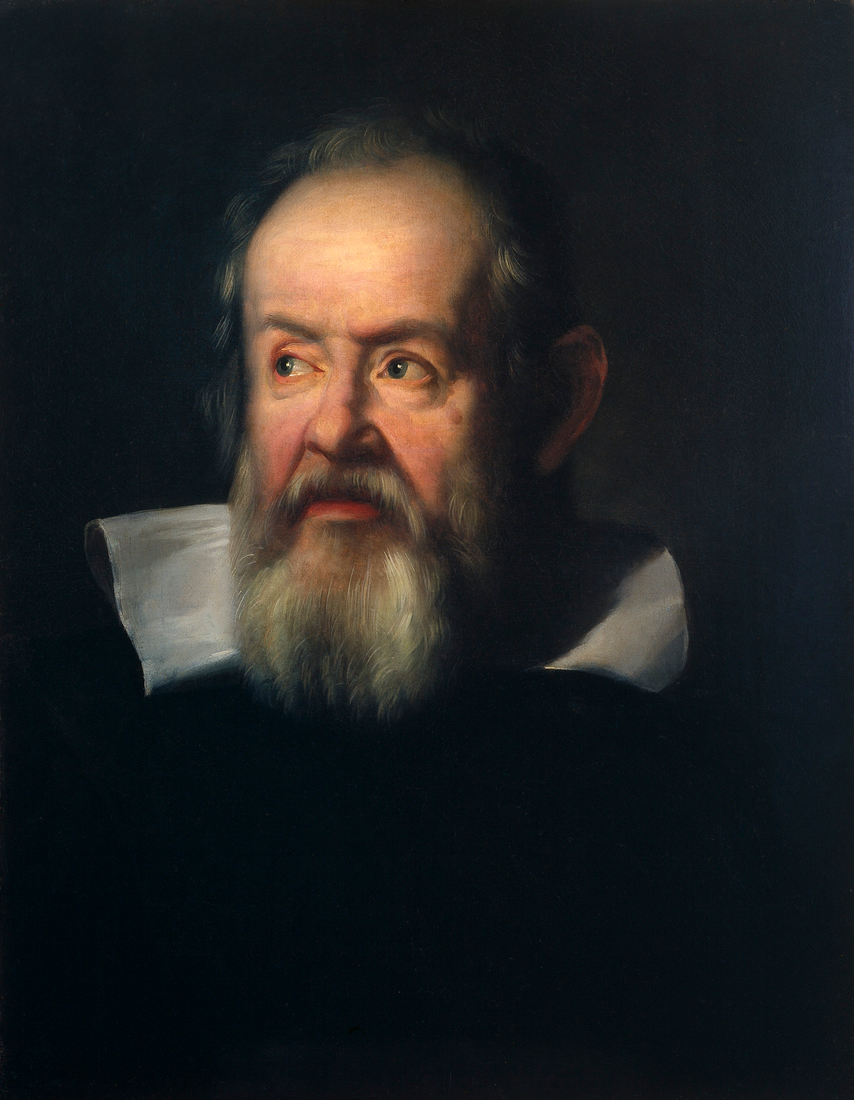
One way with lower-order variables and computation:
First, visually measure the ball’s position (distance) and velocity in the world.
Then, apply laws of projectile motion and compute the predicted course of the ball.
Third, transform into an appropriate path and velocity of locomotion.
Do all of the above in fractions of a second!
Instead, take advantage of lawful regularities.
Projectile motion + geometrical optics
Couple optics and action
Move so as to produce a given spatio-temporal optical pattern.

Slide 8
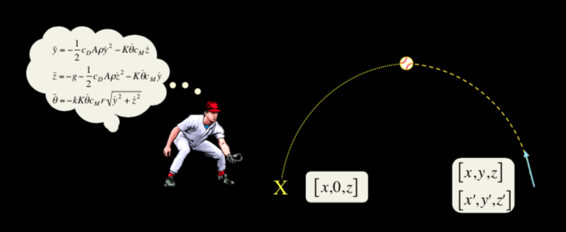
1. Model-based control: The TP strategy (Saxberg, 1987)
The outfielder has an internal model of physical laws
See ball’s image and image motion → compute ball trajectory, predict landing point → run there
BUT: poor sensitivity to distance and velocity along the depth dimension at 30m
Studies showed that outfielders continuously track the ball and can’t identify correct trajectories (Schafer & McBeath, 2005)

Slide 9
2. Online control: OAC (+ CB)
Control movement in two directions: lateral and radial (Chapman, 1968)
Move sideways so to get into the plane of ball’s motion
Move front and back so to make contact with ball
Control of lateral movement: constant baring (CB) strategy
Control of radial movement: optical acceleration cancellation (OAC) strategy
Independent!
✅
❓

Slide 11
Constant bearing (Lateral)
Move so that the bearing direction (bearing angle) of ball is constant
ASSUMPTION: Getting into the plane of ball fly is easy!
Radial motion is challenging.

Slide 12
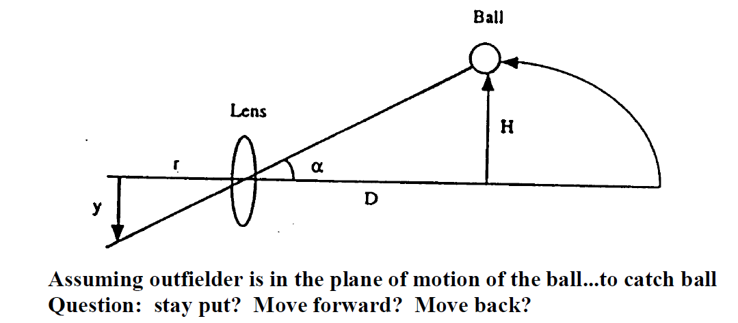
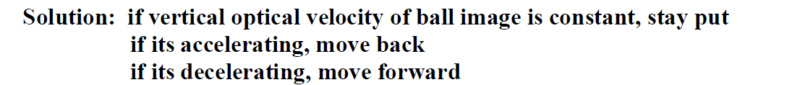
OAC (Radial)
But, visual sensitivity to acceleration??
(Babbler & Dannemiller, 1993; Brouwer, Brenner & Smeets, 2002)

Slide 13
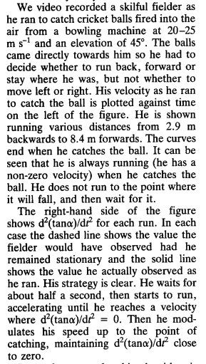
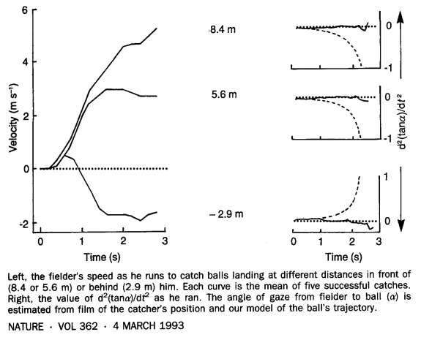
The OAC strategy (Optical Acceleration Cancellation):
(Assuming that the fielder is already in the same plane with the flying ball.)
To catch the flying ball, one moves so as to cancel the vertical optical acceleration. Equivalently, to preserve a constant optical vertical velocity.
(Michaels & Oudejans, 1992; Babler & Dannemiller, 1993; McLeod & Dienes, 1993. McLeod, Reed & Dienes, 2001, Kistemaker, Faber & Beek, 2009)
Notes:
From the vel profile (left figure): The fielder is always running when catching the ball – he does not predict the ball’s landing, run there, stop and wait for the ball (not using the TP strategy).

Slide 14
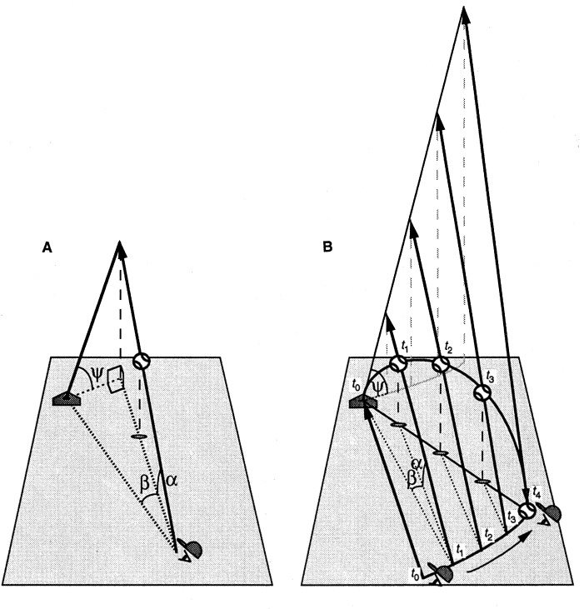
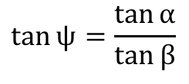
2. Online control: LOT
Can’t assume that lateral movement is easy!
The LOT strategy (Linear Optical Trajectory):
Move so as the produce a linear optical path of the image of the ball.
α (angle of elevation) and β (angle of azimuth, related to bearing angle) are not independent! They are coupled.
Run to keep the ball’s optical trajectory linear, or to keep tan ψ constant
$$\tan{ψ}=\frac{\tan{α}}{\tan{β}}$$
Problem with the LOT:
The solution is not unique. There exist different linear optical paths and not all of them lead to intercepting the ball.

Slide 15
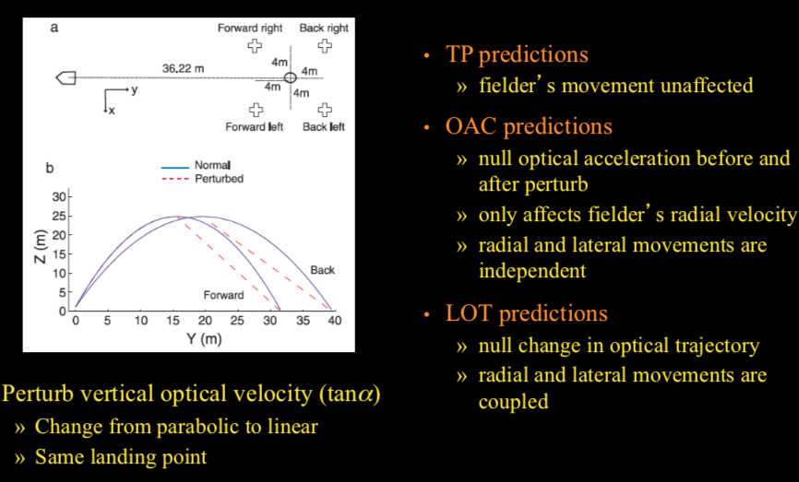
Comparing the strategies (Fink, Foo & Warren, 2009)

Slide 16
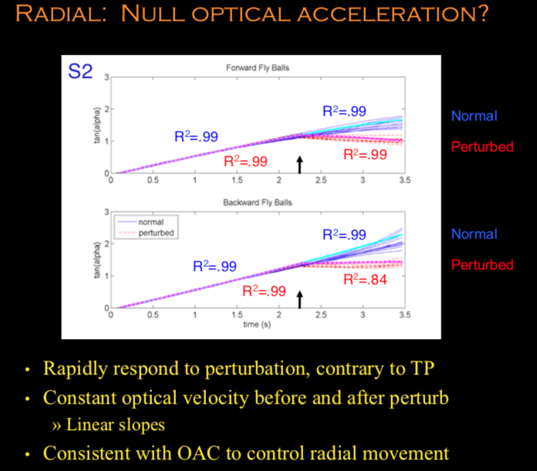
elevation
elevation

Slide 17
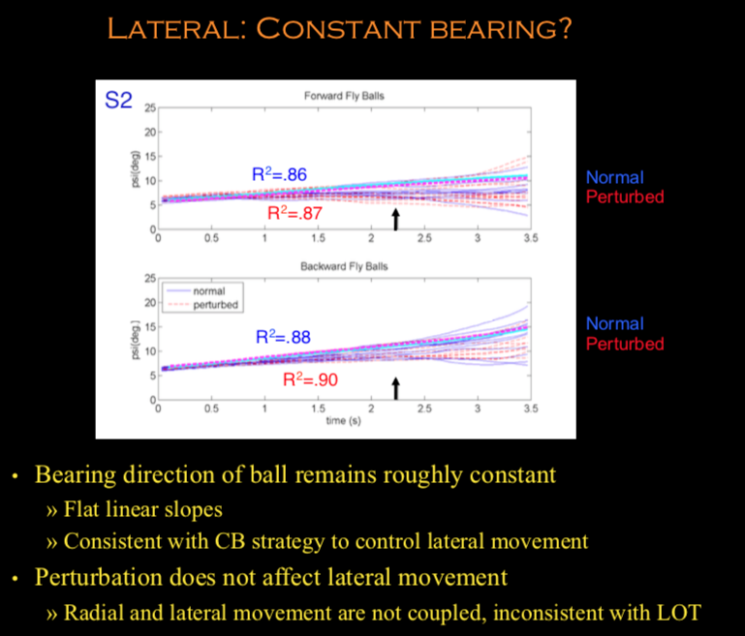
Bearing/azimuth

Slide 18
Tentative conclusions to the outfielder problem
Inconsistent with TP
Fielder tracks ball, online control of movement (control while moving)
Contrary to model-based (a priori) control
inconsistent with LOT
Optical trajectory is not linear
Radial and lateral movements are not coupled
Consistent with OAC
Fielder nulls optical acceleration
Fielder nulls change in bearing direction
Radial and lateral movements are indenpendent
Take-home message:
Take advantage of lawful regularities → simplicity of the solutions.
Projectile motion + geometrical optics
Couple optics and action
Move so as to produce a given spatio-temporal optical pattern.

Slide 19
II. Perceiving throwability

Slide 20
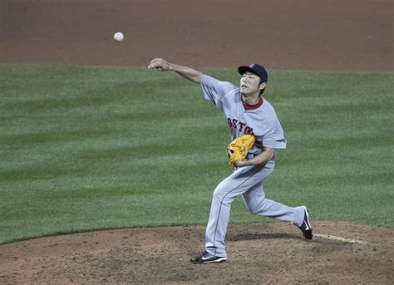
Higher-order variable to control long distance throwing
Long distance throwing (> 20m) is a unique human ability.
How to choose an ideal object (size and weight) for throwing? → affordance
What’re relevant?
Mechanics of throwing
Projectile motion
Size : graspability and air resistance
Weight: release velocity and kinetic energy
(Bingham, Rosenblum & Schimdt, 1989;
Zhu & Bingham, 2008; 2009; 2010; 2011)

Slide 21
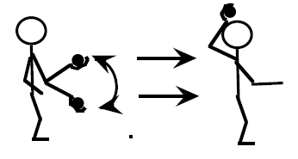
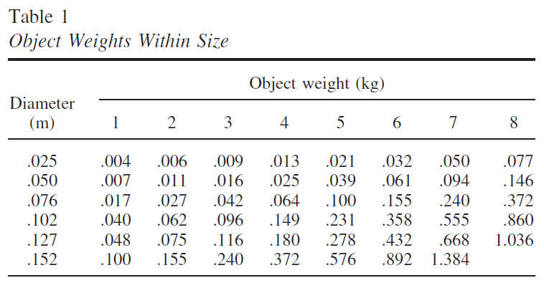
Task: for an object of a give size, pick by hefting the weight you could best throw to a maximum distance.
Pick the top 3 objects.
Throw a week later.

Slide 22
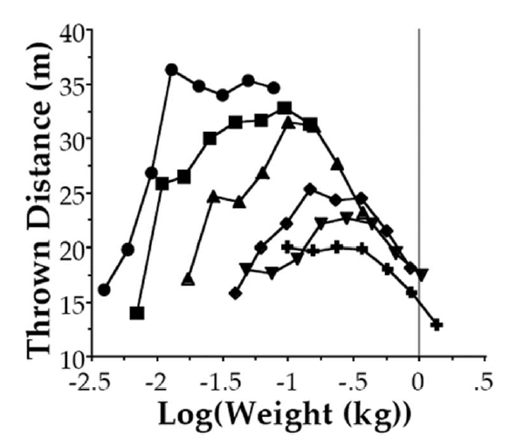
Throw all 48 objects to the max distances multiple times.
Mean throwing distance as a function of object size and log object weight
1-in. balls: circles; 2-in. balls: squares; 3-in. balls: triangles; 4-in. balls: diamonds; 5-in. balls: inverted triangles; 6-in. balls: crosses (i.e., from 2.5 cm to 15 cm in diameter).

Slide 23
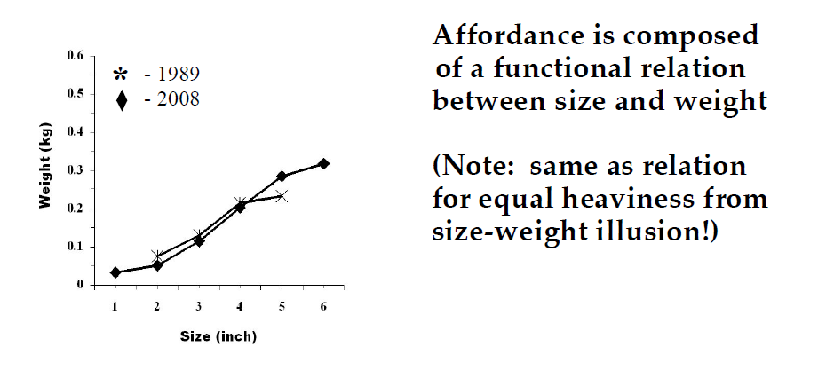
Zhu& Bingham’s result (2008): Participants perceived by hefting the object weight in each size that they could throw to a maximum distance.
Sizes and weights for throwable objects from 2 studies

Slide 24
Follow-up studies:
Zhu & Bingham (2010): Adults unskilled at long distance throwing could not perceive the affordance, but they could after learning to throw long distance (it took a month of coaching and practice)…and only if they were allowed to see the result of their throws! -- calibration
The information for throwability is heaviness, which is a function of size and weight [H = f(size, weight)]….P’s learned which heaviness corresponded to the objects that would go the farthest (the most “throwable”)
Zhu & Bingham (2011): heaviness and the size-weight relation reflect a human predisposition for long distance throwing.

Slide 25
Summary
Observers use information to accomplish perception/action tasks. The information is very often higher order variables.
In running to catch (The Outfielder’s Problem), the info may be optical acceleration, or optical trajectory… either one is ”higher-order”.
In perceiving throwability, the information is heaviness, which is a relation of size and weight of object.
These types of higher order variables (serve as information) are detected directly by the visual system – computation is not used.

Slide 26
Readings
On OAC: Mcleod, P., & Dienes, Z. (1993). Running to catch the ball.. Nature, 362(6415), 23-23.
On LOT: Mcbeath, M. K., Shaffer, D. M., & Kaiser, M. K. (1995). How baseball outfielders determine where to run to catch fly balls. Science, 268(5210), 569-573
On Throwability: Zhu, Q., & Bingham, G. P. (2008). Is Hefting to Perceive the Affordance for Throwing a Smart Perceptual Mechanism. Journal of Experimental Psychology: Human Perception and Performance, 34(4), 929-943.

